Slide 1

Performant Text Classification with Naive Bayes for Kaqchikel Maya
By: William J. Wakefield Padilla

Slide 2
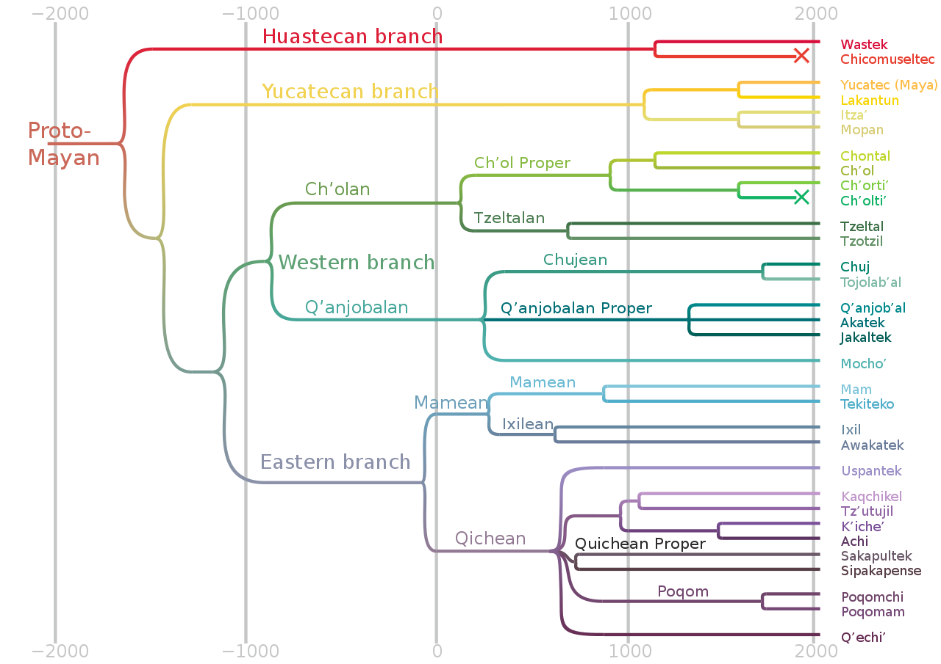
Background
410,000 Speakers
Literacy Rates are Low
There is no known NLP application

Slide 3
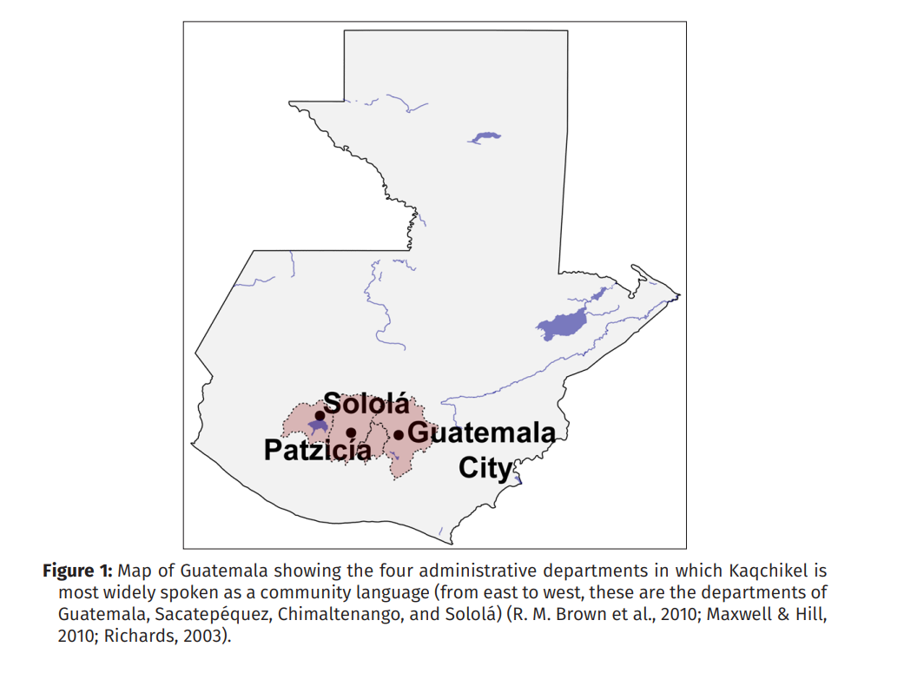

Slide 4
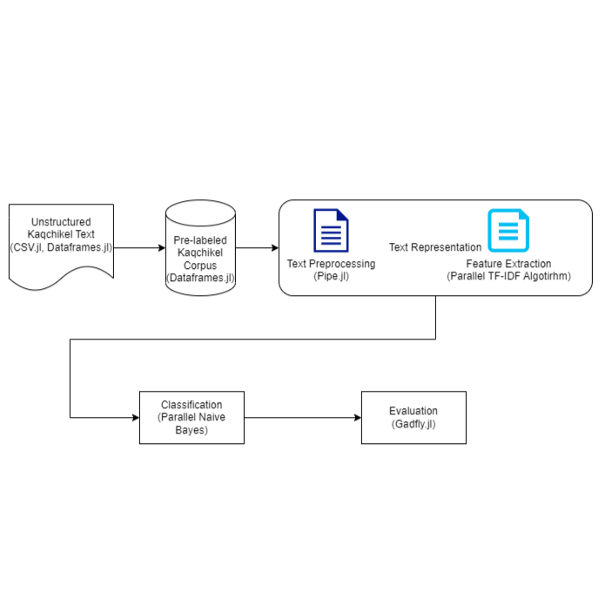


Slide 5

Unstructured Kaqchikel Corpora
Provided by Dr. Maxwell
Not as extensive but contains translations which could be useful for transformer work in the future
Religious Transcribed Texts
More formal
Does not capture modern realities of Kaqchikel
Kiwujil Xajila’ Raxche’
¶ Wawe’ xtintz’ib’aj jalajöj kitzij ri nab’ey qatata’, qamama’, ri xeme’alan, xek’ajolan winäq ojer, töq majani xek’oje’ winaqi’ chuwäch re juyu’, taq’aj re’; töq k’a ruyon umül, tz’ikin xek’oje’, xecha’. K’a ri’ xepe, xe’oqa winaqi’ wawe’ pa ri taq juyu’, taq’aj ri’. Rije’ k’a e qatata’, qamama’, ïx nuk’ajol, pa Tulan.

Slide 6

Novel Written Corpus of Kaqchikel Mayan
0.7 million word tokens
29,355 word types
Speech to Text
Spontaneous speech = More natural and relevant
Can show everyday mood and modern writing of the Kaqchikel Maya
Religious/Transcribed Texts
More historical and formal
Helps add to the lexicon
Copyright (c) 2023, Kevin Tang and Ryan Bennett

Slide 7
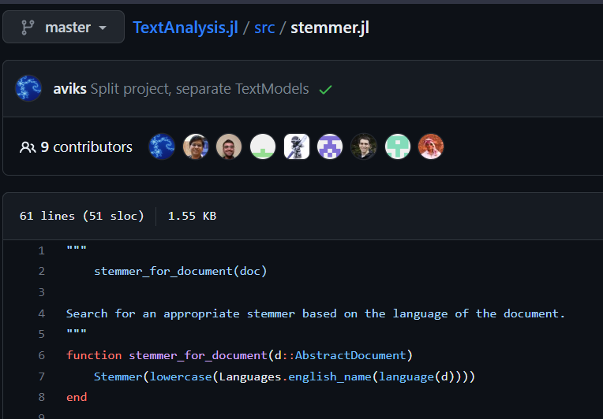
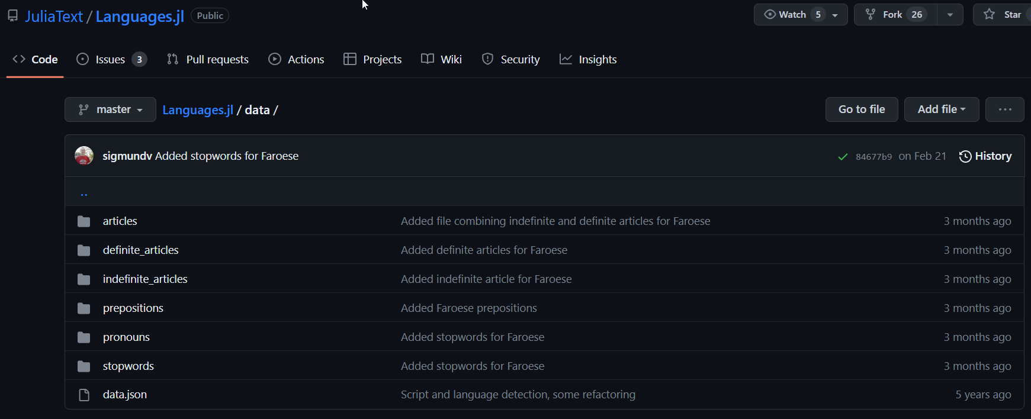
Text Preprocessing

Slide 8
Example
Töq xwiqon k'a, xkikaw, xkicha' k'a ki' kikab'ichal
Then both of them adorned, bedecked, made themselves beautiful
Qitzij k'a tixib'in öq xqaj chupam juyu’
It was in truth frightening when he descended inside the mountain.
K'oj xk'amo q'aq', k'oj mani xk'amo chi kichin.
Perhaps he would bring fire, perhaps he would not bring it to them.

Slide 9


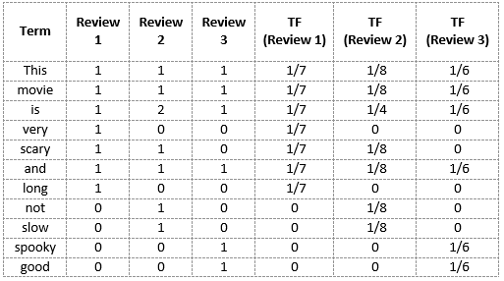

$${\left(tf−idf\right)}_{t,d}=tf_{t,d}∗idf$$

Slide 10

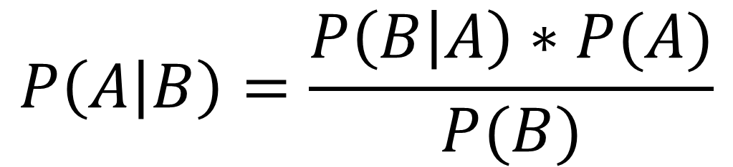

Naïve Bayes Classifier
Positive
$$P\left(A | B\right)=\frac{P\left(B | A\right)∗P(A)}{P(B)}$$
Negative

Slide 11
Potential Contributions
Language.jl
JuliaText Ecosystem

Slide 12
Next Steps
Do a trigram classification with the naïve bayes
1
Use bag of words instead of TF-IDF matrix
2

